Slide 1






CHALLENGES AND OPPORTUNITES

Slide 2

TABLE OF CONTENT
01
02
AI Ethics
Emerging Trends
03
Challenges
04
Opportunities

Slide 3
What do we mean by an emerging technology?
What do we mean by an emerging technology? What are some of its attributes?
Give examples of emerging technologies

Slide 4

Emerging Technologies
Novel.
Relatively fast-growing technology.
Prominent impact
Degree of persistent uncertainty and ambiguity.

Slide 5


Emerging Technologies
Smart cities
Generative AI.
https://www.youtube.com/watch?v=6KeVsjQmftc
Brain chip.
https://www.youtube.com/watch?v=qElV6G0nK1E
Quantum computing
https://www.youtube.com/watch?v=X8MZWCGgIb8
Notes:
Emerging technologies: patterns, behaviors, or preferences that are gaining popularity or influence in a specific industry, niche, or audience.

Slide 6
Generative AI in manufacturing
Product design and development: allow testing thousands of configuration digitally and recommend best-performing, cost-effective designs.
Predictive maintenance: simulate failures before they happen and assists technicians with troubleshooting.
Hyper personalization: enable mass customization of products tailored to each individual customer based on preferences.

Slide 7
Neuromorphic computing in manufacturing
Type of specialized computer hardware combined with a software that simulate brain-like cognitive tasks.
Mimic neural structure and functionality of the human brain.
Perform energy-efficient, event-driven processing.
Notes:
Energy Efficiency: These chips only consume power when "firing" (processing), leading to far lower power consumption than traditional CPUs or GPUs.
Memory and Computing: It often merges storage and processing (computing-in-memory) to overcome the traditional bottlenecks.

Slide 8
Neuromorphic computing in manufacturing
Deployed in edge devices: provides ultra-low power consumption suitable for battery-powered sensors.
Intelligent robotics: improve efficiency and adaptability of deployed robots.
Low latency: Millisecond-level response times ideal for critical machinery control.

Slide 9
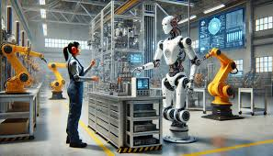
Embodied ai
Integration of AI into physical systems.
Perceive, reason and act in real-world environments.
Produce a sequence of actions to achieve a goal.
Learn from its experience instead of data sources.

Slide 10
How Embodied ai operates?
Perception: use cameras, sensors and microphones to gather data about its environment .
Reasoning and planning: using machine learning and AI, data is processed to navigate, avoid obstacles, and make decisions to complete its tasks.
Actuation (Action): motors, arms, or wheels are triggered to manipulate objects or move through the environment (transform digital decisions into physical actions).
Feedback loop: continuously updates its understanding based on the results of its actions.
Simulation to real world: robots are trained in simulated environment before deploying into the physical world.

Slide 11
Embodied ai in manufacturing
Manufacturing and assembly: replace repetitive, dangerous manual tasks and improve product quality.
Warehousing: smarter, high-speed sorting and packing.
Safety and inspection: inspect powerlines and pipelines, reducing human danger and enhancing accuracy.
Notes:
Smarter warehousing: arrange parts used together near each other for easier access.

Slide 12
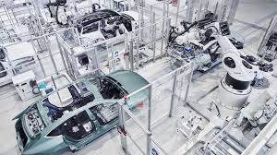
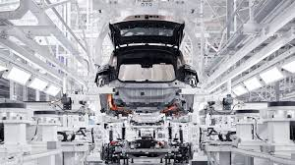
Nio’s smart manufacturing plant
Navigate automated storage systems.
Retrieve parts.
Assemble vehicle bodies.
Tangible benefits:
Increased production efficiency by 30%.
Cut labor cost by 25%.
Reduced defect rates by 40%.

Slide 13
Challenges
Battery limits:
dynamic tasks requires batteries with high discharge rates.
maintaining high performance can lead to overheating or reduce battery lifespan.
tasks involves heavy lifting and torque–heavy motion (eq. twisting) drain batteries faster.
requires fast charging

Slide 14
Challenges
Movements: embodied AI still do not fully mimic human precise and delicate movements.
Slow ROI: robots can be very expensive based on design and used materials, addition to the cost of repairing.
Adoption: workforce resistance and lack of technical talent for operating and maintaining robots.
Risk of error: the probability of making mistakes and their sequences must be fully studied.

Slide 15
Challenges
Workforce polarization: employees will be divided based on their perspective of using embodied AI.
Employees psychological strain: employees stress levels will increase because of the fear of loosing their jobs and the increment of surveillance of their productivity and work quality through visual AI.
Shifting skill requirement: there will be a need for skills related to manage and maintain embodied AI.
Human-robot relationship: embodied AI will become co-workers which can lead to overreliance on these systems and increase digital loneliness.
Notes:
Digital loneliness is the feeling of isolation, disconnection, or emotional emptiness that persists despite being highly active with systems

Slide 16
Contribution to individuals and society
Navigation and Travel: faster routes suggestion and recommending travel plans.
Security and Fraud Detection: spot potentially fraudulent activity and protect personal finances.
Scientific Discovery: AI accelerates scientific research by analyzing vast amounts of data, which speeds up drug discovery.
Enhanced Healthcare Diagnostics: AI-powered imaging systems can detect infections, cancers, and neurological problems faster and more accurately than human specialists.

Slide 17
Shaping Our Future
AI can perform tasks while human verify output, set objectives and handle exceptions.
Humanoid robots and advanced AI assistant will become common and integrates in our daily routines.
Industries such as cryptography and healthcare will be revolutionized due to advanced computation environments.
Social manipulation using fake data indistinguishable from reality can cause information disorder.
Brain rot can be caused by overreliance on technologies for creative tasks and decision-making, which erodes critical thinking.

Slide 18
AI ETHICS
Set of guiding principles that stakeholders use to ensure AI technology is developed and used responsibly.
Taking a safe, secure, humane, and environmentally approach to AI.
Stakeholders:
Academics.
Government.
Intergovernmental entities: UNESCO.
Non-profit organizations: Black in AI.
Private companies.
Notes:
intergovernmental entities: UNESCO
Non-profit organizations: Black in AI

Slide 19

ETHICAL DILEMMA
Lensa AI app.
Generate cartoon-like images from regular images.
Lensa was being trained on billions of photographs sourced from the internet without consent.
Did not give credit or enough money to artists who created the original digital art the AI was trained on.

Slide 20
Social implications
The ways in which technological advancements, cultural shifts, and political policies aﬀect society as a whole, including individuals, communities, and institutions.
Myth and fiction around AI:
absence of human-like cognitive processes.
logical deduction and critical thinking.
Social Inequality: unequal distribution of resources, opportunities, and benefits among individuals .
Eg. AI-powered healthcare systems may not be accessible to people without reliable internet access, which could disproportionately aﬀect low-income communities.

Slide 21
Security risks
Adversarial attacks: fool AI models to make incorrect decisions by manipulating data.
Malicious use of AI: using AI for unethical objectives such as automating social engineering, and targeted phishing emails.
Excessive agency: happens when AI system is granted high number of unnecessary functionality and its actions is not oversighted leading harmful unintended actions such as unauthorized deletion.

Slide 22
Security risks to users
Malicious use of personal data: publicly available data (such as on social media) can be analyzed and used for phishing or social engineering attacks.
Authentication bypass: AI can be used to break security measures by generating complex attacks or simply guessing passwords.
Privacy violation: sensitive data given to public AI applications can be used by these applications and therefore extracted by other users.

Slide 23
Security risks to organizations
Employees can be targeted through malicious attacks to hack the organization systems.
Confidential information can be leaked and unintended actions can be executed to harm the company by hacking into its AI systems.

Slide 24
Mitigation strategies
Establish AI asset inventory to identify all AI tools used within the organization.
Employees training on the risks of sharing sensitive data with external AI applications.
Adopt specialized AI security tools to detect anomalies and potential attacks.

Slide 25
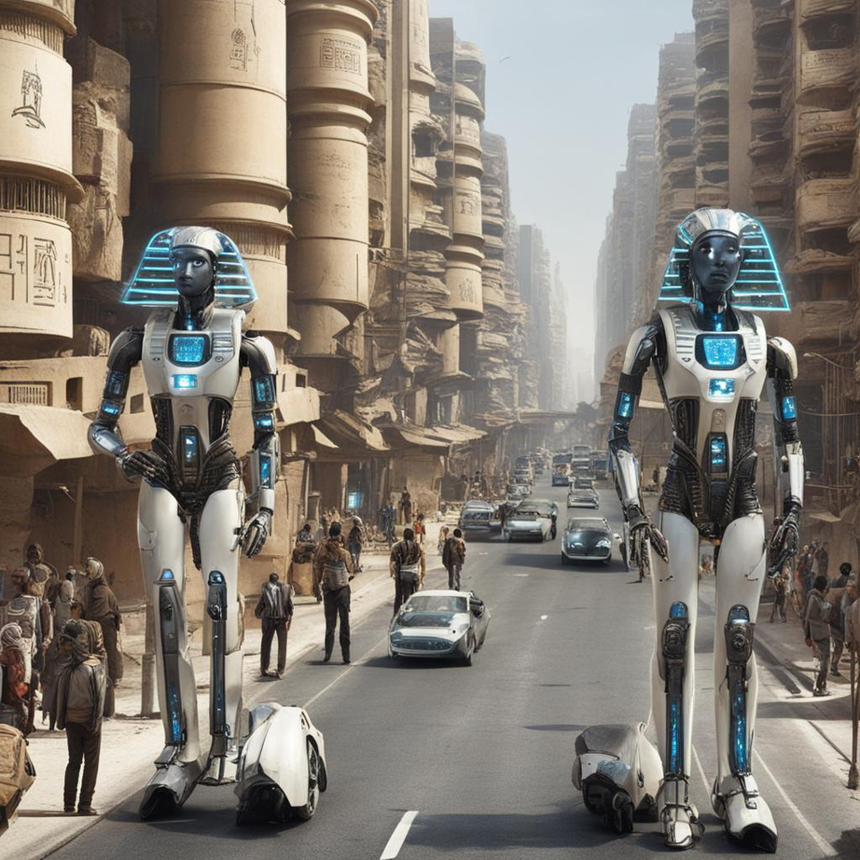
CONCERN ON AI ETHICS AND SAFETY
Survey done by British Standard Institution (BSI).
Oct. 2023.
10,000 people in 9 countries.
61% of people want international guidelines to enable safe use of AI.

Slide 26
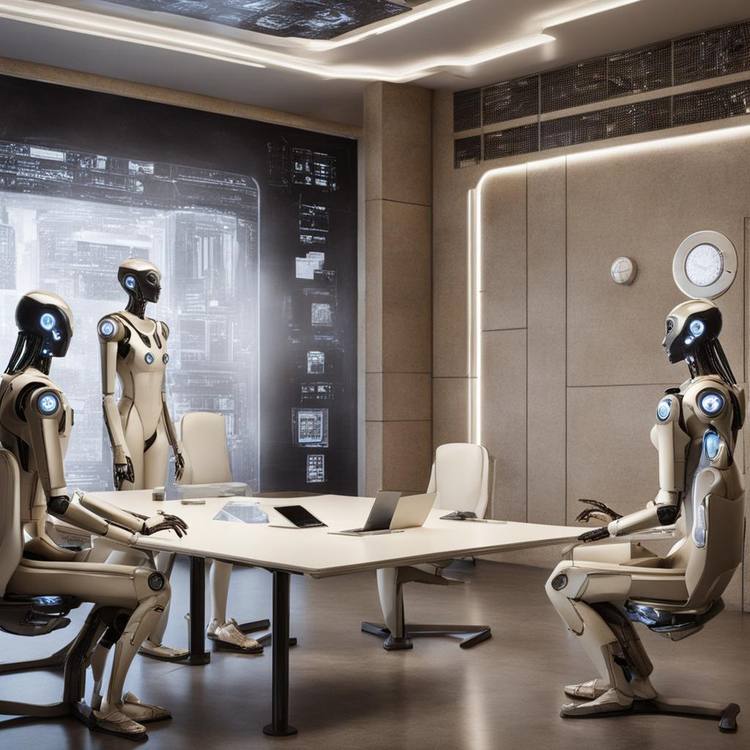
AI REGULATIONS
EU AI Act: first regulation on AI.
US: Developed new regulatory authorities to address risks posed by AI.
G7: Agreed on Hiroshima AI Process Comprehensive Policy Framework.
Japan: Established AI Safety Institute (AISI).
Notes:
G7: The Group of Seven (G7) is an informal grouping of seven of the world's advanced economies, including Canada, France, Germany, Italy, Japan, the United Kingdom, and the United States, as well as the European Union.

Slide 27
EU AI ACT
Risk level | Use | Example
Unacceptable | Prohibited | Manipulation of subconscious
High | Regulated | Medical equipment
General Purpose AI (GPAI) | Transparency requirements | Large Language Model
Limited | Lighter transparency obligations | Deep fakes
Minimal | Unregulated
Different regulations for each risk level.
Penalty of violations:
Up to 35 Million Euros or 7% of worldwide sales.
Corrective actions such as forced withdrawal of AI systems.

Slide 28
MICROSOFT RESPONSIBLE AI
Fairness: ensure equitable outcomes for all individuals.
Reliability and safety: ensure that AI systems function as intended and do not pose risks to individuals or society.
Privacy and security: safeguard individuals' data and protect against potential threats or breaches.
Inclusiveness: ensure that AI technologies are accessible and beneficial to all individuals, regardless of their backgrounds, abilities, or circumstances.
Transparency: openness, accountability, and clarity in the development and deployment of AI technologies.
Accountability: establishing mechanisms to ensure that AI systems operate ethically, transparently, and in alignment with regulatory requirements and societal expectations.

Slide 29
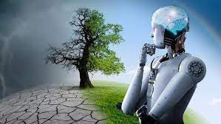
CHALLENGES
Technical challenges
data wall.
data quality and bias.
The environmental footprint of AI:
carbon impact of AI.
Notes:
carbon footprint reasons:
1-energy consumption
2-resource extraction for manufacturing hardware
data wall: a point when all the public data has been used, or locked up in licensing deals or behind paywalls.

Slide 30
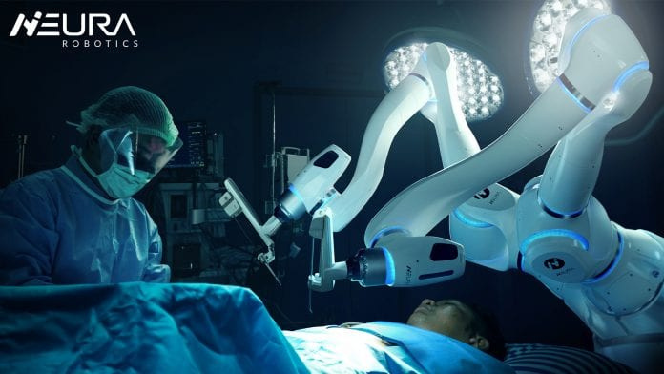
OPPORTUNITIES
Enabling affordability of services
Processing power.
GPU
TPU
LPU
https://www.youtube.com/watch?v=fKK933KK6Gg
Collaborative robot (corobot).
Reduce operational cost.

Slide 31
References
Rotolo, Daniele & Hicks, Diana & Martin, Ben. (2015). What Is an Emerging Technology?. Research Policy. 44. 1827-1843. 10.1016/j.respol.2015.06.006.
https://www.coursera.org/articles/ai-ethics
https://www.microsoft.com/en-us/ai/principles-and-approach
https://www.telefonica.com/en/communication-room/blog/what-is-a-collaborative-robot-o-corobot/
https://artificialintelligenceact.eu
https://global.chinadaily.com.cn/a/202603/21/WS69bdd906a310d6866eb3f06d.html
https://www.mckinsey.com/industries/industrials/our-insights/will-embodied-ai-create-robotic-coworkers
https://masterofcode.com/blog/generative-ai-in-manufacturing

